Slide 1



LANE DETECTION
PROJECT SUPERVISOR
Dr..N.SUGITHA,M.E.,Ph.D.
Projectcoordinator
Dr._________________.
BY,
SRINIVASAN E V 212221060261
ROHAN T 2122210228
KISHORE KUMAR R 212221060128
ECE Dept.

Slide 2
abstract
Lane Line detection is a critical component for self driving cars and also for computer vision in general. This concept is used to describe the path for self-driving cars and to avoid the risk of getting in another lane.
In this article, we will build a machine learning project to detect lane lines in realtime. We will do this using the concepts of computer vision using OpenCV library. To detect the lane we have to detect the white markings on both sides on the lane.
Using computer vision techniques in Python, we will identify road lane lines in which autonomous cars must run. This will be a critical part of autonomous cars, as the self-driving cars should not cross it’s lane and should not go in opposite lane to avoid accidents.

Slide 3
objective
Lane Line detection is a critical component for self driving cars and also for computer visionvin general. This concept is used to describe the path for self-driving cars and to avoid the risk of getting in another lane.

Slide 4
Literature survey
Jae-Hyun Cho et al. (2014)[1] applied the Hough transform with optimized the accumulator cells in the four ROI in parallel and detects lanes with high efficiency. Although Hough Transform can detect only straight lines, the poor lane recognition rate on the curve road has been resolved fairly.
Chan Yee Low et al. (2014) [2] presented a robust road lane marker detection algorithm to detect the left and right lane markers. The algorithm consists of optimization of Canny edge detection and Hough Transform. Canny edge detection performs features recognition then followed by Hough Transform lane generation. Hough Transform is applied to find relevant lines that can be used as the left and right lane boundaries. Reducing the image to smaller region of interest can reduce high computational cost.
F. Mariut (2012) [3] proposed a simple algorithm that detects the lane marks and its characteristics and is able to determine the travelling direction. The Hough Transform was used to detect the lines in images. A technique was developed for extracting inner margin of lane to ensure right detection of lane mark.
KamarulGhazali et al. (2012) [4]proposed an algorithm for detecting unexpected lane changes. An algorithm based on H-maxima and improved Hough Tranform was proposed which defines region of interest from input image and then divides the image into near and far field of view. Hough Transform was applied on near field of view to detect lane marks after noise filtering. The results showed that this algorithm is effective for straight roads.

Slide 5
Existing system
In the current existing system is permitted only to use in ideal road conditions such as runway. This could not be used in general roads because the edge detection used till now was Simulink Edge Detection which is implemented in MATLAB. The secondary thing is in current system Hough transform Space is only used for angle rotation and has very limited road dataset to detect the objects in single dimension of an image

Slide 6
Proposed system
In our proposed system we use Canny Edge Detection replacing the Simulink Edge Detection which is recent and efficient implementation in Python instead of MATLAB. Since, Python is the Scripting and Statistical Modelling Language it supports faster execution for mathematical functions which could be used by Canny Edge Detection technique. Secondly, we use Hough Transform Space for 3-Dimensional Object detection which could faster and accurate compared to single dimension object detection.

Slide 7
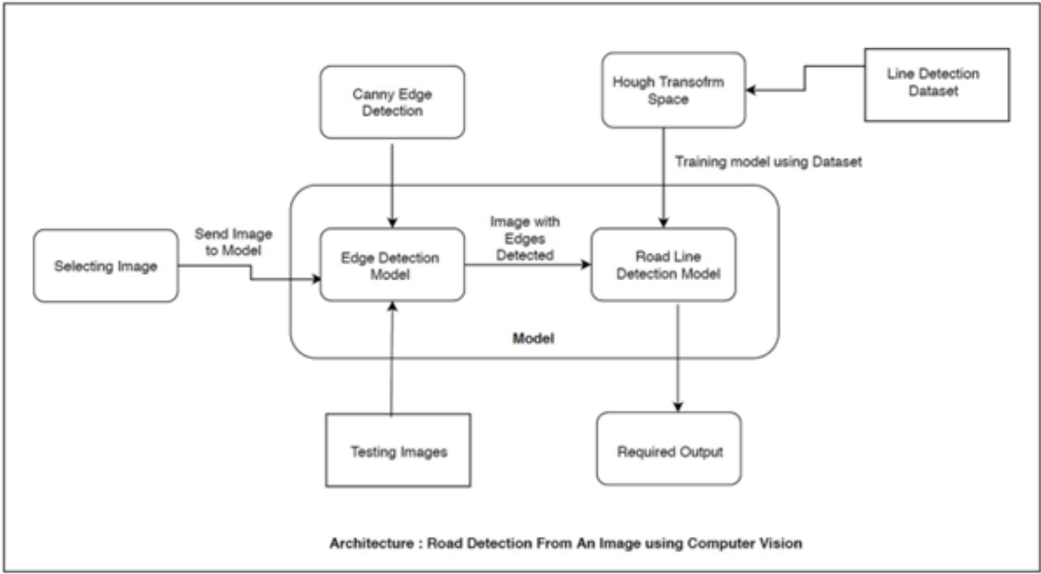
architecture

Slide 8
Module
Module 1: Selecting the appropriate testing image and video Module 2: Preprocessing the selected image Module 3: Edge Detection Implementation Module 4: Hough Transformation Module 5: Evaluating the output

Slide 9
Module 1: Selecting the appropriate testing image and video
This selection of image is more important because implementation of each model requires an image input for processing. And if the processing is done, then output is produced. If output produced for the testing image is same as required , then the resultant image is sent to next process that we need to develop further.

Slide 10
Module 2: Preprocessing the selected image
Preprocessing of selected image mainly undergo the gray scale conversion and smoothening techniques which would be considered as the first process in Canny’s process

Slide 11
Module 3: Edge Detection Implementation
The next step in the process if edge detection, which is main part in the program and required to detect the edges in the image irrespective of details present in an image. We use Canny Edge Detection Algorithm to implement the edge detection techniques because the other processes which are also used to find the edges in an image would contain detailed images compared to Canny Edge Detection Technique.

Slide 12
Module 4: Hough Transformations
The Hough transform is a technique which can be used to isolate features of a particular shape within an image. Because it requires that the desired features be specified in some parametric form, the classical Hough transform is most commonly used for the detection of regular curves such as lines, circles, ellipses, etc.

Slide 13
Module 5: Evaluating the output
Evaluation of output is done through confusion matrix and the accuracy metrics when a testing dataset is passed. When all the images of testing dataset are passed into the model, then the output is observed on every image and then the true positives, false positives, true negatives ,false negatives are noted. This forms a confusion matrix and then accuracy, precision scores can be noted. This process is known as Evaluation. Thus, all the accuracy and precision of a model are noted.

Slide 14
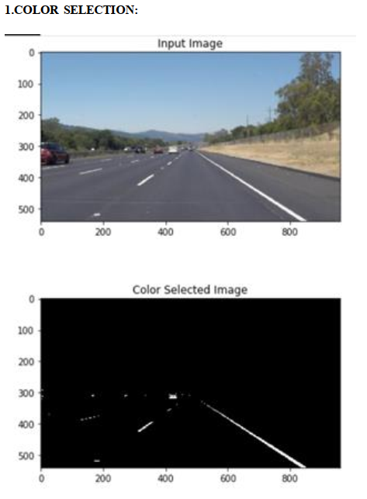
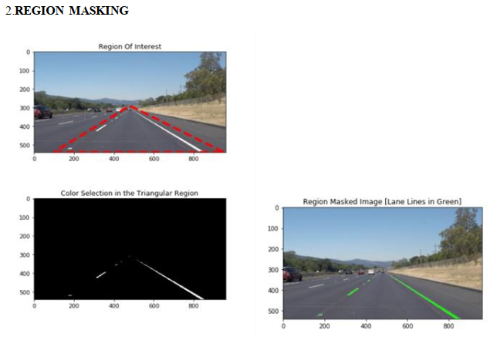
result

Slide 15
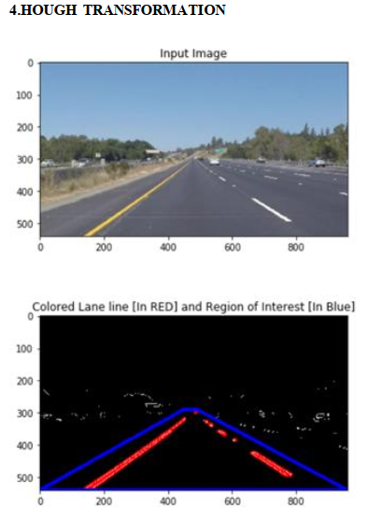
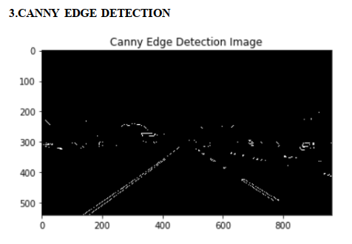

Slide 16
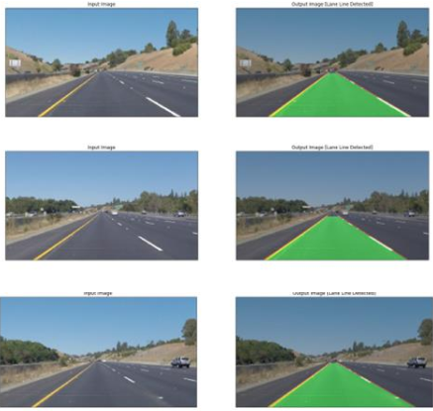

Final output

Slide 17
Conclusion
Driverless cars appear to be an important next step in transportation technology. They are a new all-media capsule- text to your heart’s desire and it’s safe. Developments in autonomous cars is continuing and the software in the car is continuing to be updated. Though it all started from a driverless thought to radio frequency, cameras, sensors, more semiautonomous features will come up, thus reducing the congestion, increasing the safety with faster reactions and fewer errors.

Slide 18
Future work
This model can be updated and tuned with more efficient mathematical modelling, whereas the classical OpenCV approach is limited and no upgrade is possible as the approach is not efficient It is unable to give accurate results on the roads which do not have clear markings present on the roads. Also it cannot work for all climatic conditions This technology is increasing the number of applications such as traffic control, traffic monitoring, traffic flow, security etc.

Slide 19
references
1. General Road Detection From A Single Image, TIP-05166-2009, ACCEPTED, Hui Kong , Member, IEEE, Jean-Yves Audibert, and Jean Ponce , Fellow, IEEE Willow Team, Ecole Normale Superieure / INRIA / CNRS, Paris, France Imagine team, Ecole des Ponts ParisTech, Paris, France. 2. J. C. McCall and M. M. Trivedi, “Video based lane estimation and tracking for driver assistance: Survey, system, and evaluation,” IEEE Trans. on Intelligent Transportation Systems, pp. 20 –37, 2006. 3. K.-Y. Chiu and S.-F. Lin, “Lane detection using color-based segmentation,” IEEE Intelligent Vehicles Symposium, 2005. 1 4. H. Kong, J.-Y. Audibert, and J. Ponce, “Vanishing point detection for road detection,” CVPR, 2009. 5. Y. Wang, E. K. Teoh, and D. Shen, “Lane detection and tracking using b-snake,” Image and Vision Computing, pp. 269–280, 2004

